Slide 1

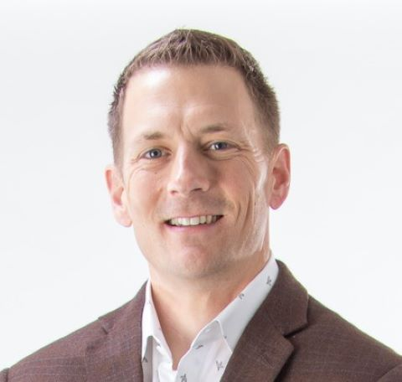
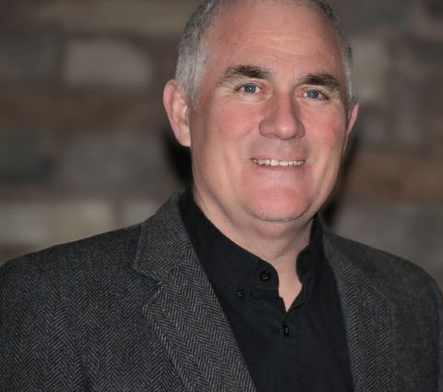

Understanding and Minimizing the Cost of Rework in Construction
Travis Davis, CPCU
Brian Clarke, CSP
SVP, Broker
Managing Partner
Alliant Insurance Services
Quality Safety Times
CA License No. 0C36861
© 2024 Alliant Insurance Services, Inc.
SWCA – 2025 Construction Executive Summit

Slide 2
Why are we here?
We have each heard from Owners, Contractors, and Insurers that Re-Work is a growing problem.
We believe this is a problem worthy of an industry-wide response, rather than depending on marketplace incentives.
The model exists for correcting this problem.
“Cut first, fix it later.” - Chat GPT on the modern worker
CA License No. 0C36861
© 2024 Alliant Insurance Services, Inc.
SWCA – 2025 Construction Executive Summit

Slide 3
Audience Poll
Who is in the room?
Construction company executives / operations
Construction company risk managers / safety / HR
Project Owners
Industry partners
CA License No. 0C36861
© 2024 Alliant Insurance Services, Inc.
SWCA – 2025 Construction Executive Summit
Notes:
We would like to find out who is in the audience so that we make sure to address and respond to the different perspectives in the room. It’s easy for me to see through the lens of my experience, but identifying the roles each of us have in this room will help us see through your eyes. We each have our own perspective and those are usually in tension, however with this issue I believe we’re all aligned.

Slide 4
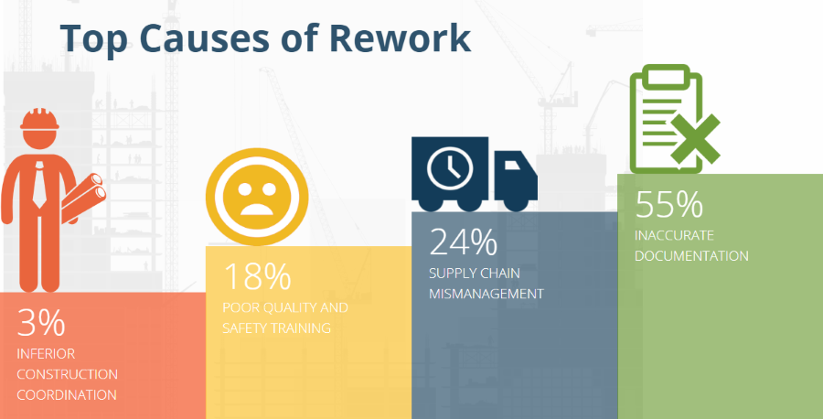
Academic Research
Recent Studies show up to 30% of Construction Costs are directly related to Rework.
* UK Construction Task Force
Rework is estimated to represent between 2% and 20% of total costs, averaging 12%.
* Construction Industry Institute (CII)
- US Construction Volume is $2 trillion
- Construction Rework is a $200 billion opportunity for our industry in the US alone
CA License No. 0C36861
© 2024 Alliant Insurance Services, Inc.
SWCA – 2025 Construction Executive Summit
Notes:
Construction Coordination
Poor quality and safety training
Supply chain management – incorrect materials or sequenced incorrectly due to timing
Incorrect documents – in design, shop drawings, as-builts

Slide 5
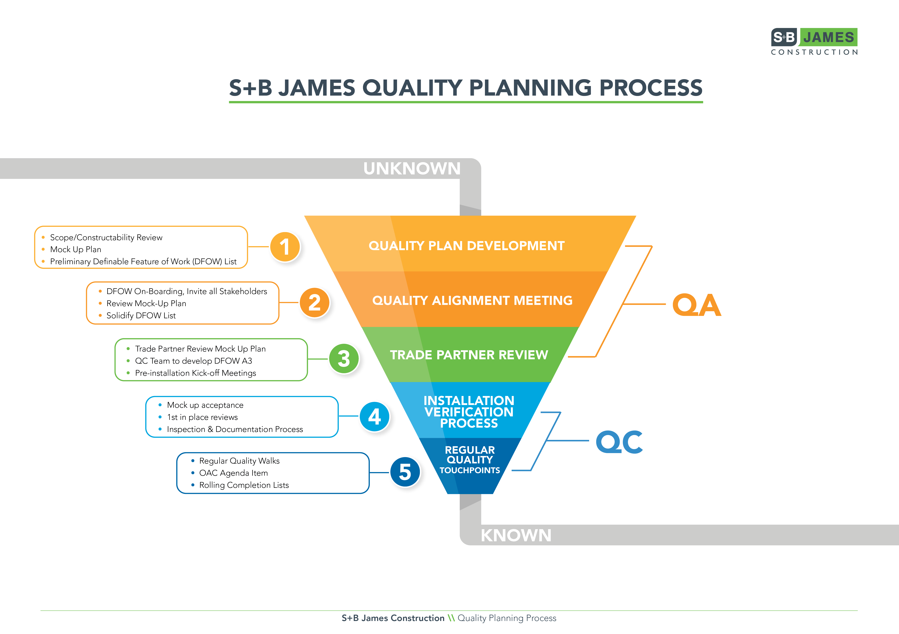
A Contractor’s Perspective
CA License No. 0C36861
© 2024 Alliant Insurance Services, Inc.
SWCA – 2025 Construction Executive Summit
Notes:
Silas presents his perspective on the pursuit of quality, of minimizing re-work, on the spectrum of quality he sees from his subcontractors and his construction peers in the marketplace. Also discusses the expectations of owners, impacts on owners, etc.

Slide 6
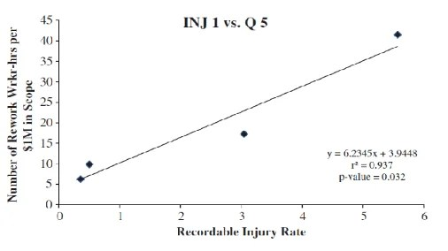
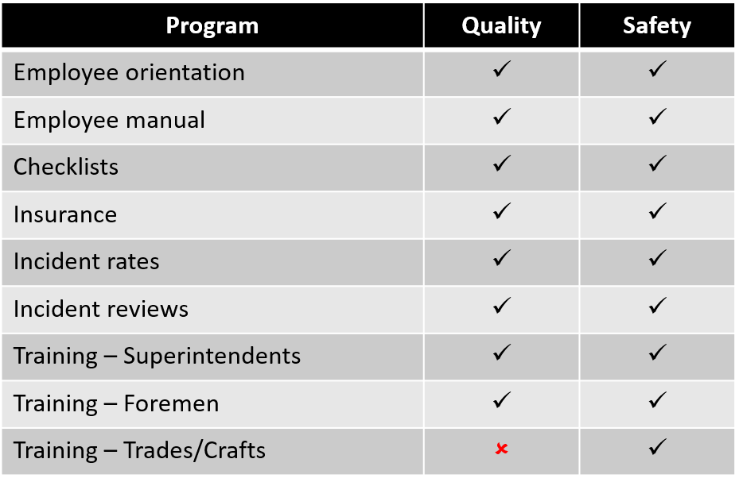
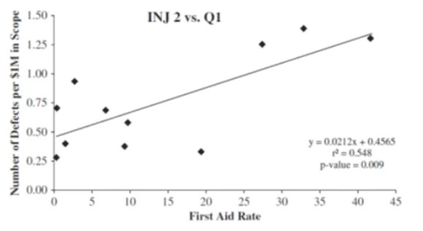
Parallels between Safety and Quality
CA License No. 0C36861
© 2024 Alliant Insurance Services, Inc.
SWCA – 2025 Construction Executive Summit
Notes:
Chart from research that Sathy did: Relationship between Construction Safety and Quality Performance, Abstract. https://ascelibrary.org/doi/full/10.1061/(ASCE)CO.1943-7862.0000732 (J. Wanberg, C. Harper, M. Hallowell, S. Rajendran. 2013). Everyone in the Loss Contorl world knew there was a relationship between projects bad housekeeping, poor safety, behind schedule, cost increased for rework But until Dr Satyh did this reasrch no “acidimic research. At Continental I would rate a project for underwriting in first 30 seconds based on housekeeping anlone…
Chart showing the parallels between safety and quality – where this came form was article Richard Andres with Zuric and I wrote after he was assigned to HOFFMAN to help us “formalize our Quality program…. 15 years ago… One thing we could not get done was the part of the safety program where craft had weekly training… If you accept the fact that safety and quality is same process just different content, then we as an industry are missing one of the most important parts of our program, no weekly reinforcement of the importance of building it right the first time.

Slide 7
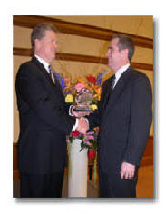
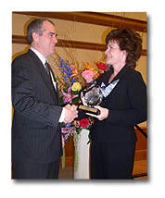
Evolution of Safety, as a guide for Quality
2003 Gary E Bird Horizon Award
Jack Gibson
Donna Bird
CA License No. 0C36861
© 2024 Alliant Insurance Services, Inc.
SWCA – 2025 Construction Executive Summit
Notes:
Donna Bird, wife of the late Gary E. Bird, congratulates Mr. Clarke
Brian Clarke of Hoffman Corporation, right, and Jack Gibson, IRMI president
Cost of accident story (great intern project)

Slide 8
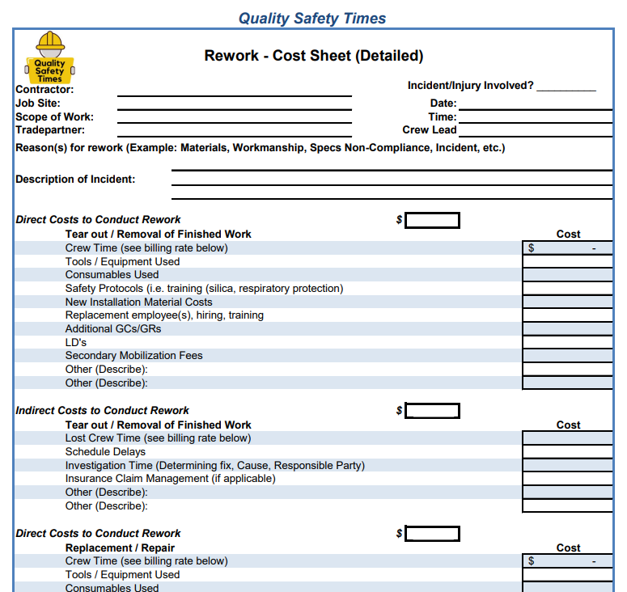
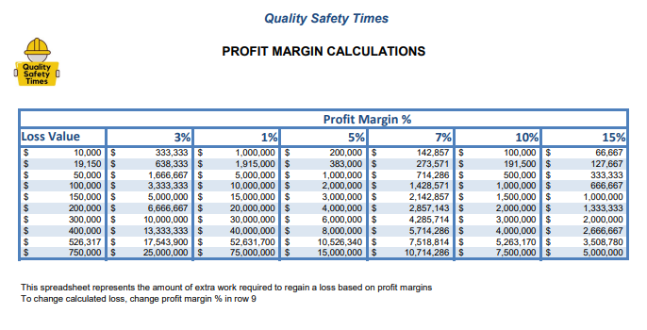
How to measure Re-Work
What gets inspected gets inspected
What gets measured gets results
CA License No. 0C36861
© 2024 Alliant Insurance Services, Inc.
SWCA – 2025 Construction Executive Summit
Notes:
Recall the Cost of Incident Worksheet Brian used to teach Forman, subcontractors and superintends about the real costs of injuries? What is here for you to use (think of summer intern project) is work sheet to track time and un-insuraned costs of re-work.
Next chart is real cool to drive point home about the impact of these costs. It is a simple excel spreadsheet showing the cost of incident on left comul with profit margin across the top with the amount of work (concrtet to be poured) to recove that loss… That really dives the point home to foreamn about ‘how much work they have to do do cover these “hidden” costs of Re-work

Slide 9
Loss Analysis – Water loss during construction
Water mitigation and demo $120,000
Repair/replace drywall, insulation, flooring, cabs, etc. $450,000
_________
Total cost of Re-work due to one loose fitting $570,000
CA License No. 0C36861
© 2024 Alliant Insurance Services, Inc.
SWCA – 2025 Construction Executive Summit

Slide 10
Loss Analysis – Water loss during construction
Water mitigation and demo $120,000
Repair/replace drywall, insulation, flooring, cabs, etc. $450,000
Additional project overhead – 8 week delay $80,000
_________
Total cost of Re-work due to one loose fitting $650,000
CA License No. 0C36861
© 2024 Alliant Insurance Services, Inc.
SWCA – 2025 Construction Executive Summit

Slide 11
Loss Analysis – Water loss during construction
Water mitigation and demo $120,000
Repair/replace drywall, insulation, flooring, cabs, etc. $450,000
Additional project overhead – 8 week delay $80,000
Lost productivity – all other trades $300,000
_________
Total cost of Re-work due to one loose fitting $950,000
CA License No. 0C36861
© 2024 Alliant Insurance Services, Inc.
SWCA – 2025 Construction Executive Summit

Slide 12
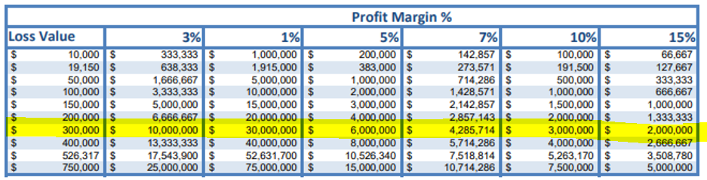
Loss Analysis – Water loss during construction
Water mitigation and demo $120,000
Repair/replace drywall, insulation, flooring, cabs, etc. $450,000
Additional project overhead – 8 week delay $80,000
Lost productivity – all other trades $300,000
Lost Business Income – Owner $400,000
_________
Total cost of Re-work due to one loose fitting $1,350,000
Less Insurance Coverage $1,050,000
Total uncovered loss by GC and Subcontractor $300,000
CA License No. 0C36861
© 2024 Alliant Insurance Services, Inc.
SWCA – 2025 Construction Executive Summit

Slide 13
Work Volume required to overcome the Loss
Total uncovered loss by GC and Subcontractor $300,000
CA License No. 0C36861
© 2024 Alliant Insurance Services, Inc.
SWCA – 2025 Construction Executive Summit

Slide 14
Loss Analysis – Fireproofing
Remove and Replace Framing/Drywall $125,000
Remove FP and apply intumescent paint $30,000
_________
Total cost of Re-work $155,000
CA License No. 0C36861
© 2024 Alliant Insurance Services, Inc.
SWCA – 2025 Construction Executive Summit

Slide 15
Loss Analysis – Fireproofing
Remove and Replace Framing/Drywall $125,000
Remove FP and apply intumescent paint $30,000
Additional Project Overhead – 6 week delay $50,000
_________
Total cost of Re-work $205,000
CA License No. 0C36861
© 2024 Alliant Insurance Services, Inc.
SWCA – 2025 Construction Executive Summit

Slide 16
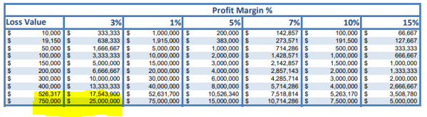
Loss Analysis – Fireproofing
Remove and Replace Framing/Drywall $125,000
Remove FP and apply intumescent paint $30,000
Additional Project Overhead – 6 week delay $50,000
Loss Business Income – Owner $705,000
_________
Total cost of Re-work $910,000
CA License No. 0C36861
© 2024 Alliant Insurance Services, Inc.
SWCA – 2025 Construction Executive Summit

Slide 17
Audience Poll
Do you believe the costs of rework have increased in the last 5-10 years?
Absolutely
Somewhat
Not at all
CA License No. 0C36861
© 2024 Alliant Insurance Services, Inc.
SWCA – 2025 Construction Executive Summit
Notes:
At this point I’d like to pause and check in with you all – what do you think? How bad is the problem really?

Slide 18
If we could reduce Rework, what do we have to gain?
Contractors want reduced call-backs and predictable project delivery, leading to higher profits
Insurance carriers want to reduce claim frequency and severity, leading to higher profits
Project Owners want to decrease overall project costs both directly and indirectly, leading to higher profits
CA License No. 0C36861
© 2024 Alliant Insurance Services, Inc.
SWCA – 2025 Construction Executive Summit

Slide 19
How do we get there?
Invest in our People
Track Re-Work and align goals within the organization
Budget for craft training (safety and quality)
Contract verbiage requiring weekly safety & quality crew meetings
Update Pre-task planning forms to include “quality”
Require “Site specific QC plan” in the RFP
As part of contractor selection process include QC (every project)
Refocus (cross-train) Safety staff for Quality
CA License No. 0C36861
© 2024 Alliant Insurance Services, Inc.
SWCA – 2025 Construction Executive Summit

Slide 20
Recap
The cost of Rework is over $200B annually in the US
State of the Market is making this problem worse, not better
  Record construction volume
  Skilled Labor shortage
What gets Measured gets Results
Just like Safety, our industry can rethink our approach to Quality
“If not now, when? If not me, then who?”
- ???
CA License No. 0C36861
© 2024 Alliant Insurance Services, Inc.
SWCA – 2025 Construction Executive Summit
Notes:
Not John F Kennedy, not Malcom X…actually from Rabbi Hillel the Elder in the first century BCE.

Slide 21
Questions?
CA License No. 0C36861
© 2024 Alliant Insurance Services, Inc.
SWCA – 2025 Construction Executive Summit
Notes:
Brian closing comments:
I’ve been involved with Bill McIntyre and ACIG since 1987 when I was at Continental Insurance
ACIG was one of many of my construction accounts
It was obvious then that they were some of the best contractors in the United States at managing risk
Tie in ACIG to IRMI
In safety we greatly improved by just the way we measured results
We can accomplish the same results in quality by the leaders in this room giving the same dedication of improving quality
The members in this room are the leaders in the industry – change is going to come from you all, not from regulators

