Slide 1
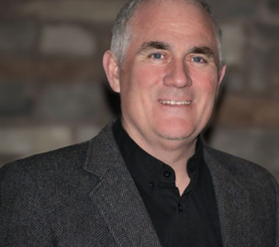
The Cost of Re-Work
Brian Clarke, CSP
Managing Partner
Quality Safety Times
GEWllc Safety Consulting

Slide 2
Loss Prevention
Employee Safety
Fleet Management
Public Protection
Building Protection
Contents
Wrongful Dismissal, Harassment, etc.
Business Interruption
Inland Marine
Quality Control *Today’s emphasis
Notes:
I started my professional at insurance company. We cared about losses not code nor regulatory.
Before we go too far – first and alway first is caring about safety and health of our employees If employees hurt we don’t build
Consider these loss prevention factors…
Say a few words about each
Today’s presentation emphasizes “Quality Control”

Slide 3
Why Are We Here this AM
Costs of Re-Work
Parallels Safety and Quality
A little reference CII and AIA
Worksheet to Identify Losses
Recommendation to reduce $$$
Maybe a Marketing Opportunity for you
Notes:
I started my professional at insurance company. We cared about losses not code nor regulatory.
Before we go too far – first and alway first is caring about safety and health of our employees If employees hurt we don’t build
Consider these loss prevention factors…
Say a few words about each
Today’s presentation emphasizes “Quality Control”

Slide 4
Parallels Safety and Quality Program Components
Safety
Quality
Leadership Engagement
Contractual Requirements
Pre-Construction Meetings
Inspection Processes
Orientations
JHA/PTP/A3 processes
Task Specific Training (i.e. fall protection, confined space)
Weekly Safety Meetings/ Toolbox Talks
After Action Reviews/Lessons Learned
Drug and Alcohol Testing
Leadership Engagement
Contractual Requirements
Pre-Construction Meetings
Inspection Processes
Orientations
JHA/PTP/A3 processes
Task Specific Training (i.e. fire caulking, mock-up testing)
Weekly Quality Meetings/ Toolbox Talks
Lessons Learned
Notes:
AIA – indicates that training requirements in your contract is a critical component of a contractors quality control program
Anybody do training for quality control – Raise your hand.
Leave quality side blank – white board/flip chart

Slide 5
Parallels between Safety and Quality
Notes:
Chart from research that Sathy did: Relationship between Construction Safety and Quality Performance, Abstract. https://ascelibrary.org/doi/full/10.1061/(ASCE)CO.1943-7862.0000732 (J. Wanberg, C. Harper, M. Hallowell, S. Rajendran. 2013). Everyone in the Loss Contorl world knew there was a relationship between projects bad housekeeping, poor safety, behind schedule, cost increased for rework But until Dr Satyh did this reasrch no “acidimic research. At Continental I would rate a project for underwriting in first 30 seconds based on housekeeping anlone…
Chart showing the parallels between safety and quality – where this came form was article Richard Andres with Zuric and I wrote after he was assigned to HOFFMAN to help us “formalize our Quality program…. 15 years ago… One thing we could not get done was the part of the safety program where craft had weekly training… If you accept the fact that safety and quality is same process just different content, then we as an industry are missing one of the most important parts of our program, no weekly reinforcement of the importance of building it right the first time.

Slide 6
Cost of Re-work
“The unnecessary effort of redoing a process or activity that was incorrectly implemented in the first instance”
OR
NOT BUILDING IT RIGHT THE FIRST TIME
Research
Egan – up to 30% (project costs)
CII – 12% (contract budget)
Rhodes – 12.4% (project costs)
Palaneeswaran 3.8% of project costs)
Notes:
Google and type in Re-work costs commercial Construction
My loss 20% on week payroll officers
(to summarize – the research is telling us the cost of rework is significant and it is increasing.)
What are the costs of business interruptions or re-work?
Speak to graph

Slide 7
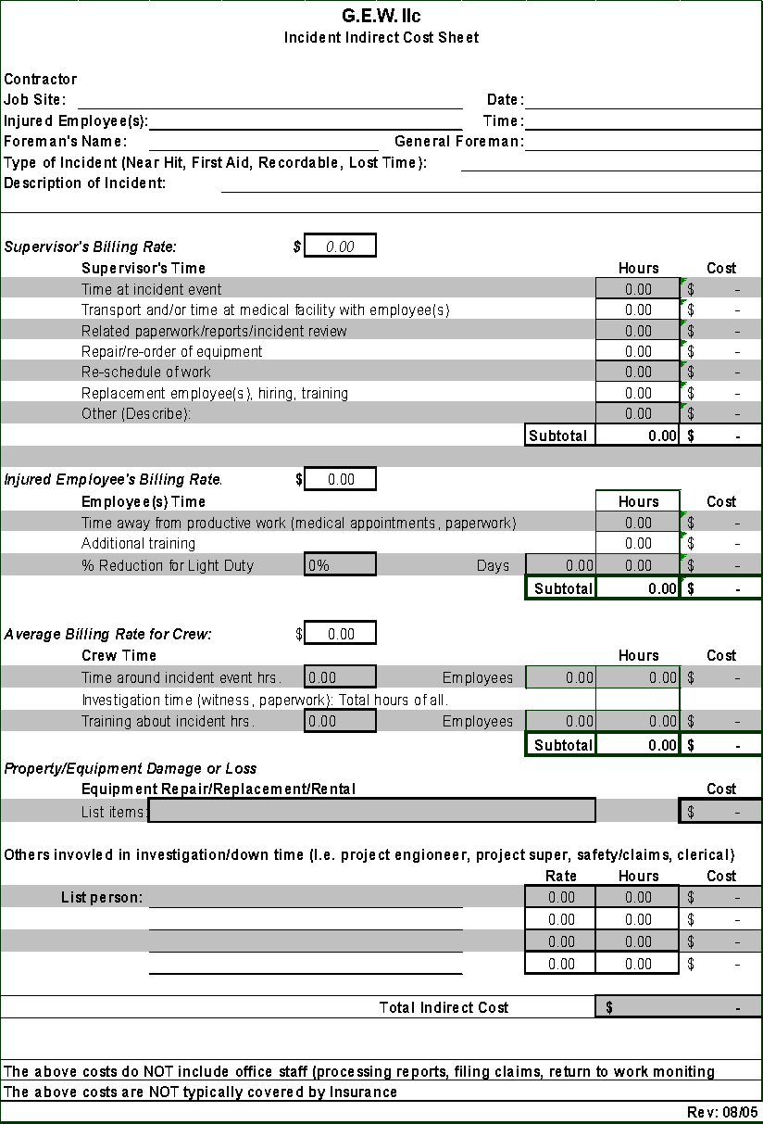
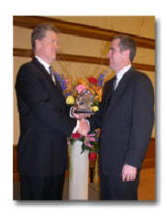
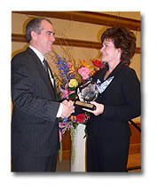
Evolution of Safety - a guide for Quality
2003 Gary E Bird Horizon Award
Jack Gibson
Donna Bird
Notes:
Donna Bird, wife of the late Gary E. Bird, congratulates Mr. Clarke
Brian Clarke of Hoffman Corporation, right, and Jack Gibson, IRMI president
Cost of accident story (great intern project)
Tell story about Sathy and Tracking costs of Incidents
Dick Silima asked me what was I doing with spreadsheets….
Send to Subs best was Carr construction (Great company) Curtis Anderson Called me ‘kenny wanted me to ask you what this is for” So I asked What does Kenny think it is Bill) what do you think it is Curtis “I think its an ass chewing”. They had no idea of the loss they were taking (mostly in time).

Slide 8
How To Measure Re-work
What gets inspected gets inspected
What gets measured gets results
Notes:
Recall the Cost of Incident Worksheet Brian used to teach Forman, subcontractors and superintends about the real costs of injuries? What is here for you to use (think of summer intern project) is worksheet to track time and uninsured costs of re-work.
Next chart is real cool to drive point home about the impact of these costs. It is a simple excel spreadsheet showing the cost of incident on left comul with profit margin across the top with the amount of work (concrete to be poured) to recover that loss… That really drives the point home to foreamn about ‘how much work they have to do do cover these “hidden” costs of Re-work

Slide 9
Parallels Safety and Quality
Notes:
LOSS Control/claims Management
After the Fact – Defect Claim / Accident
Change checklists to inspection processes
Incident Rates - ???
Incident Reviews - ???
People correct on the job – great for the job; how do we share it
Near miss – near hit – how do we share
Claims review meetings / incident review meetings
(somewhere – construction defect claims - discovery)
Consulting experts for mediation / trial
Notes:
To summarize the article and what Bill Drinkward and I did for Hoffman’s first corporate Quality Control Program was the successful programs in our Safety (injury prevention program)
we added checklists, progress photos, incident reviews, hired people with letters after their name, had training sessions for superintendents, Operations managers, started doing a lot more muck-ups.

Slide 10
Industry Associations
Construction Industry Institute
AIA Contract Doc
Key Components of Quality Control in Construction Contracts
Inspection and Testing
Doc and Record Keeping
QA Plan
Training and Certification
Sub Management
Change Management
Zero Accidents Task Force
High-Impact Zero Injury Safety Techniques
1. Pre-Project/Pre-Task Planning for Safety
2. Safety Orientation and Training
3. Written Safety Incentive Program
4. Alcohol and Substance Abuse Program
5. Accident/Incident Investigations
Notes:
AIA – indicates that training requirements in your contract is a critical component of a contractors quality control program
Anybody do training for quality control – Raise your hand.
Leave quality side blank – white board/flip chart

Slide 11
So Now What?
An Opportunity to Evaluate
Invest in our People
Track Re-Work Costs and Impacts
Budget for craft training (safety and quality)
Update Pre-task planning forms to include “quality”
Require “Site specific QC plan” in the RFP
As part of contractor selection process include QC (every project)
Refocus (cross-train) Safety staff for Quality
Update your contract verbiage requiring weekly Safety & Quality crew meetings

Slide 12
YOUR Marketing Opportunity
Assumption – Negotiated
Interview Process
Tell Owner RE-WORK Costs
What are you going to do
* Site Specific QA/QC plan
* Pre Task Plans
* Pre-Task Plans
* Weekly Craft QC Topics
Construction Industry Institute
Zero Accidents Task Force
High-Impact Zero Injury Safety Techniques
2. Safety Orientation and Training
AIA Contract Doc
Key Components of Quality Control in
Construction Contracts
4. Training and Certification
Notes:
AIA – indicates that training requirements in your contract is a critical component of a contractors quality control program
Anybody do training for quality control – Raise your hand.
Leave quality side blank – white board/flip chart

Slide 13
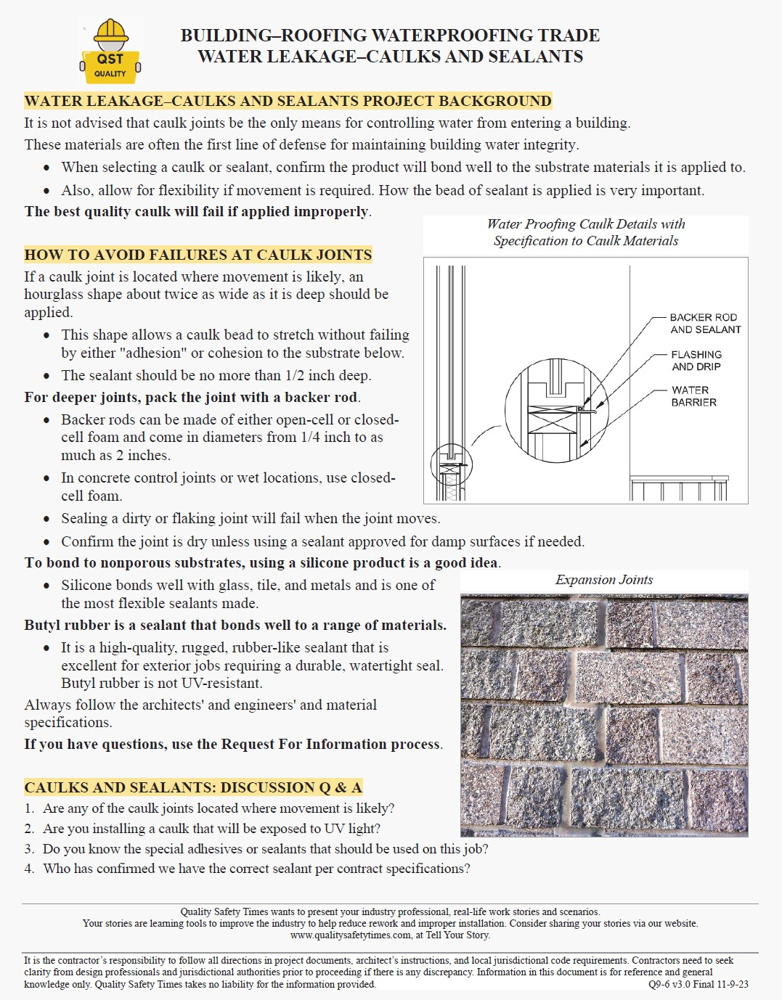
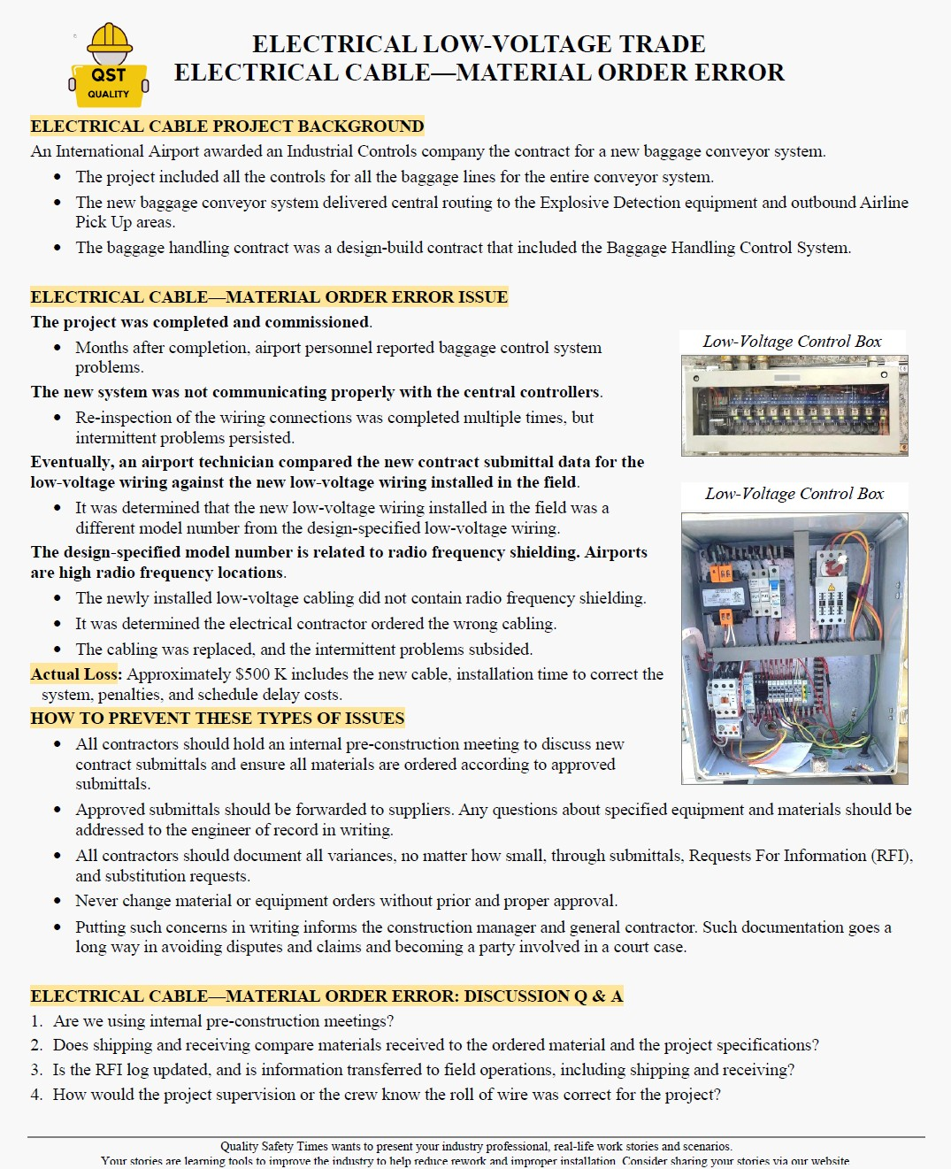
MY Marketing Opportunity
Name one CM, GC or Sub in USA that has Weekly QC Topics for Trades
“Not holding weekly, craft-level trade-specific “quality” trainings is like having a great safety program without weekly safety meetings”
Notes:
AIA – indicates that training requirements in your contract is a critical component of a contractors quality control program
Anybody do training for quality control – Raise your hand.
Leave quality side blank – white board/flip chart

Slide 14
Questions?
COME SEE US AT OUR BOOTH
Rework examples available on our website
Watch for our article in April Professional Safety Journal
Notes:
Brian closing comments:
I’ve been involved with Bill McIntyre and ACIG since 1987 when I was at Continental Insurance
ACIG was one of many of my construction accounts
It was obvious then that they were some of the best contractors in the United States at managing risk
Tie in ACIG to IRMI
In safety we greatly improved by just the way we measured results
We can accomplish the same results in quality by the leaders in this room giving the same dedication of improving quality
The members in this room are the leaders in the industry – change is going to come from you all, not from regulators

